Slide 1
The Rise of the Machines
by Peter DeMartini
Your feedback is important to us
Please text @T63 to 39242
Thank you!

Slide 2
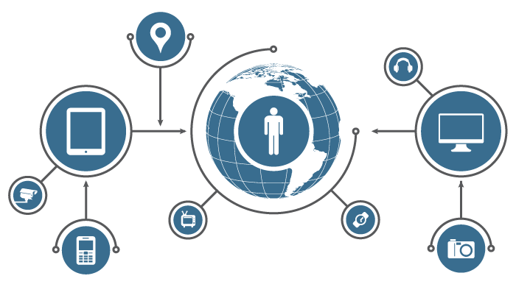
What is the
Internet of Things?

Slide 3
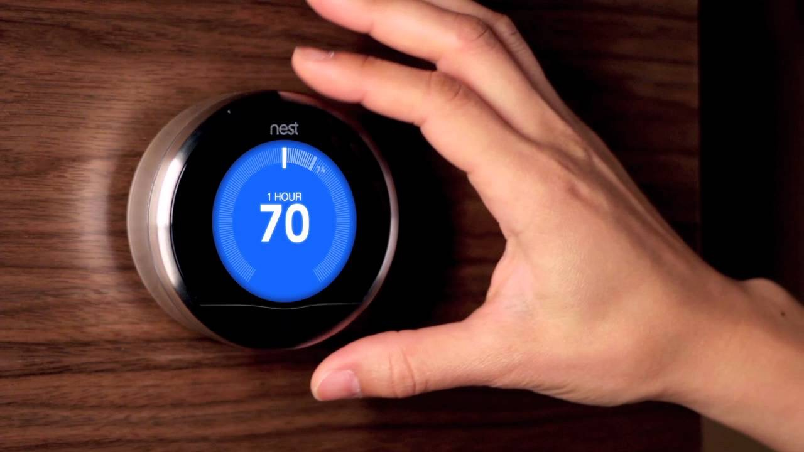

Slide 4
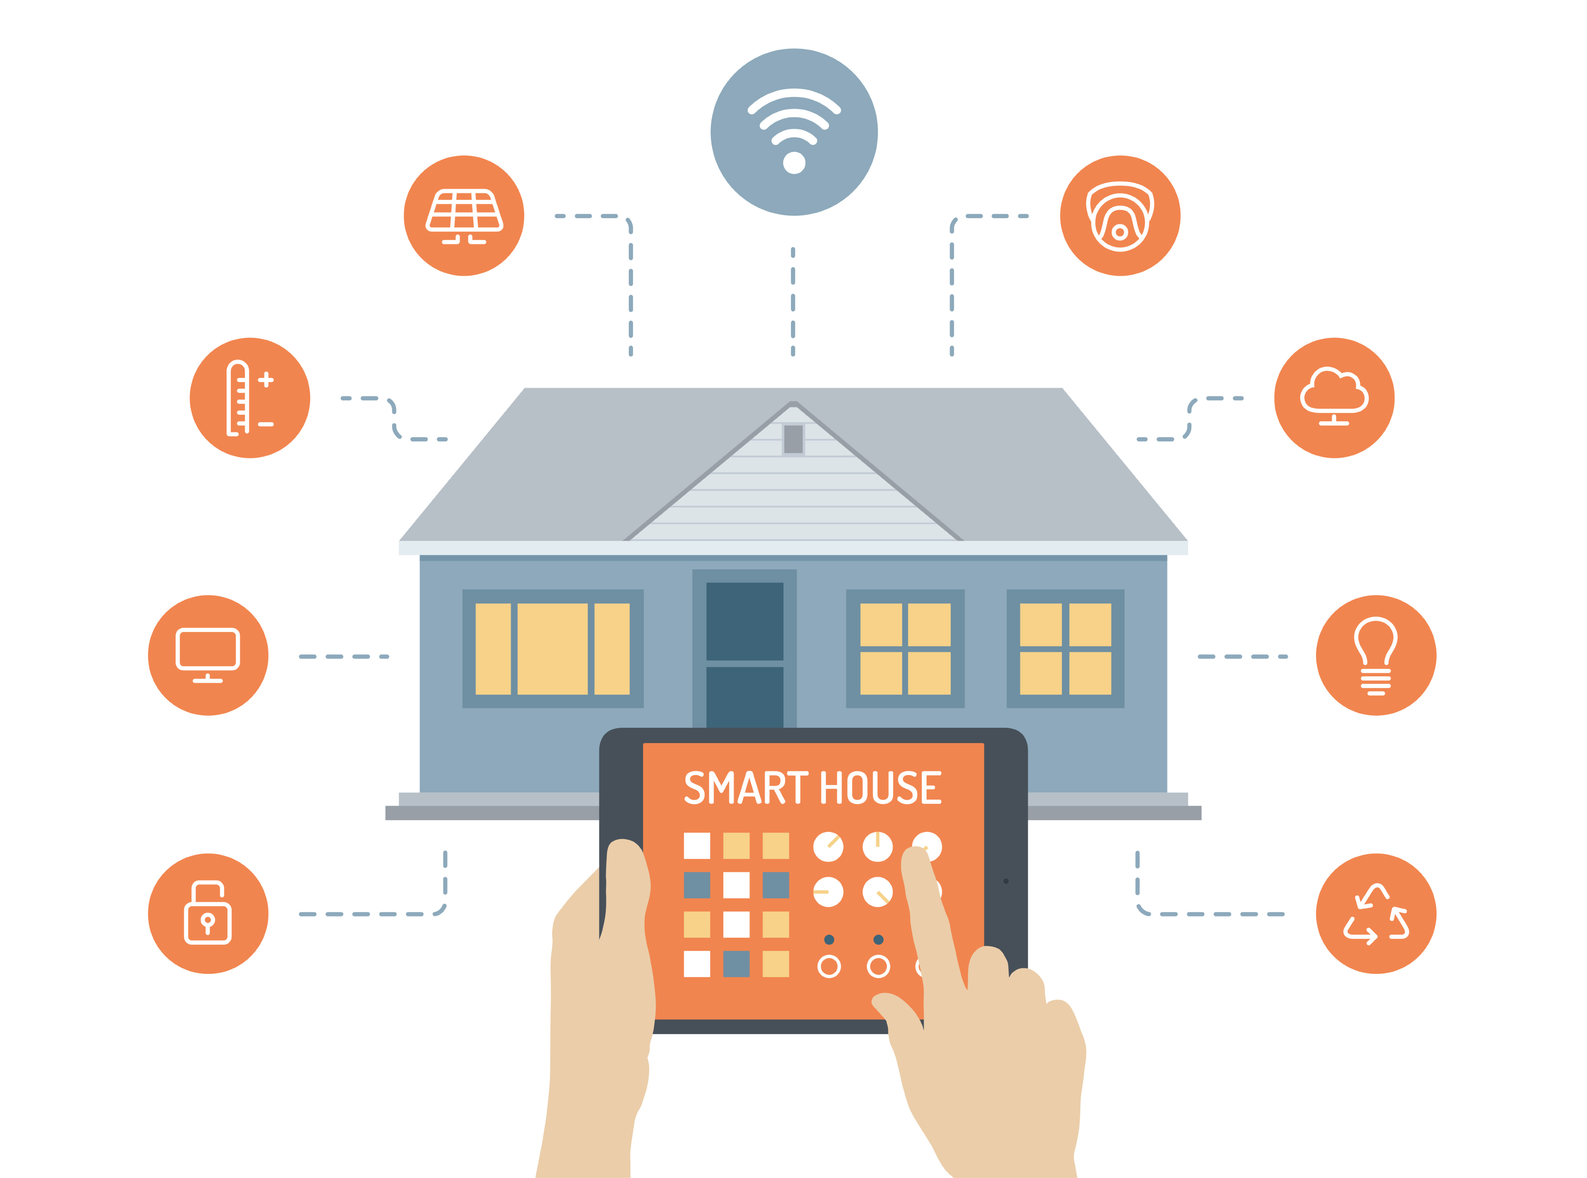
Smart Devices, Connected to Everything

Slide 5
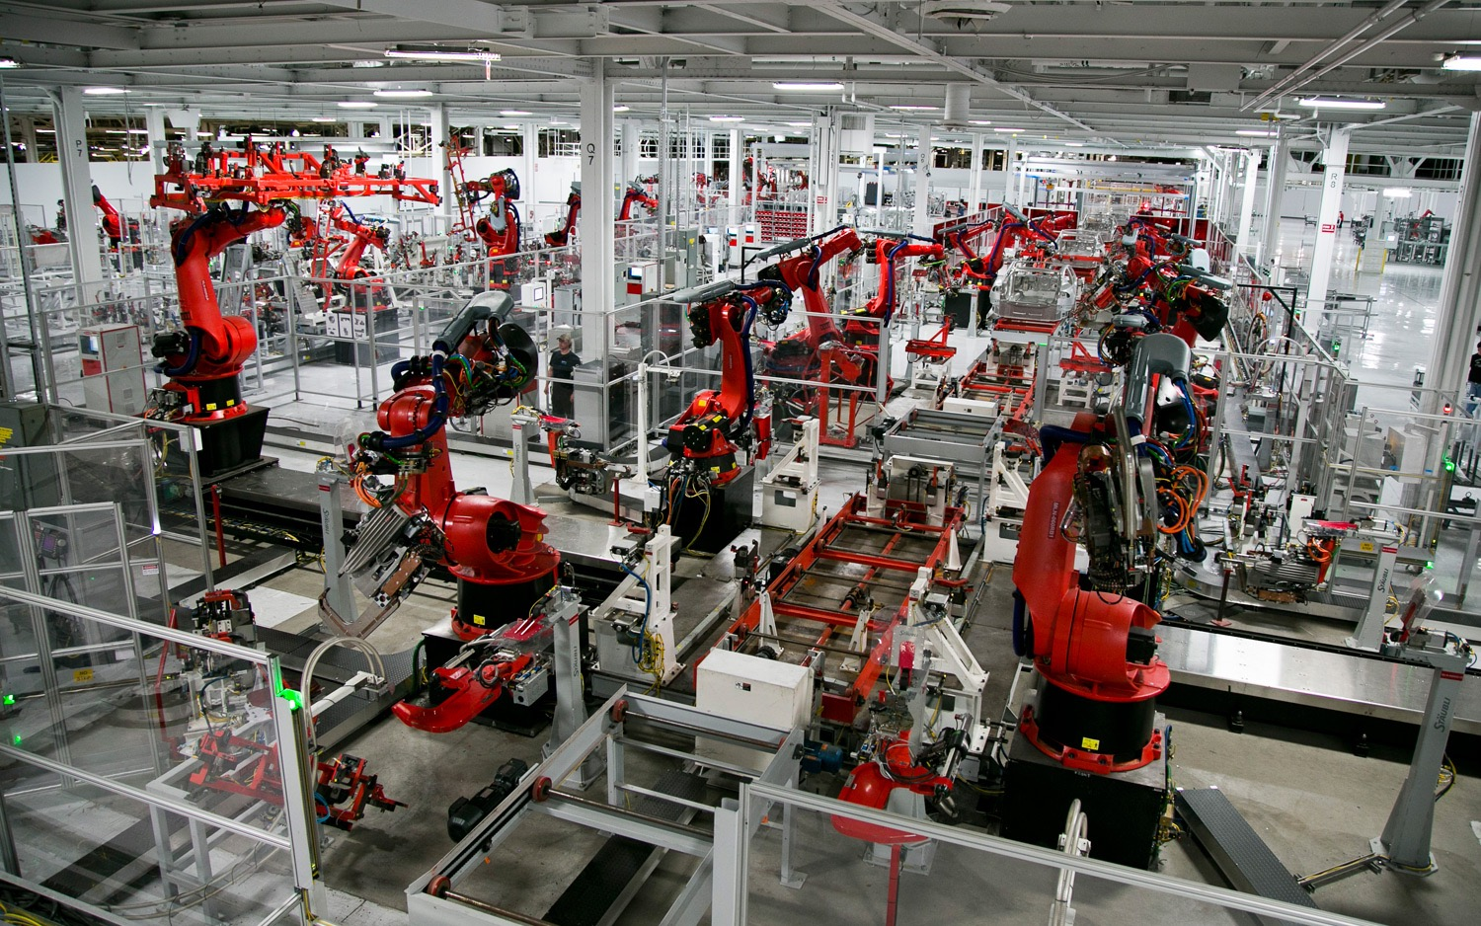

Slide 6
“The Internet of Things has the potential to change the world, just as the internet did. Maybe even more so.”
~ Kevin Ashton

Slide 7
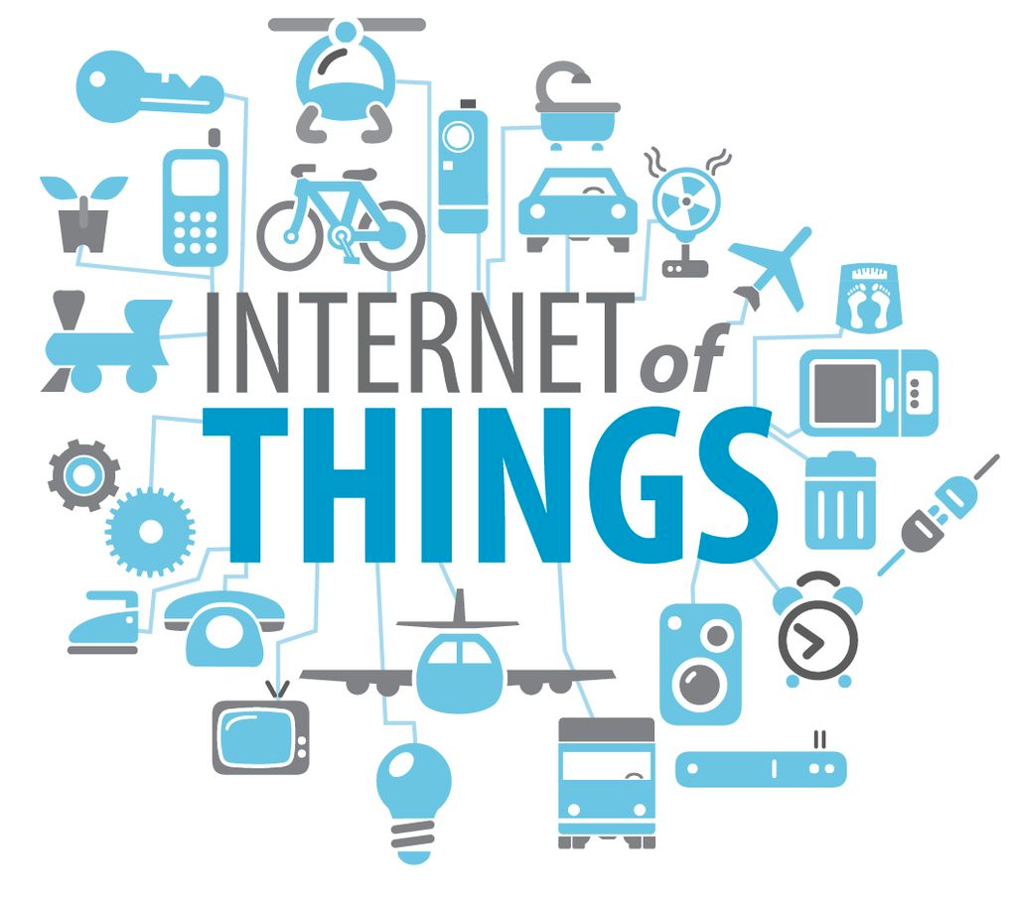
- Device Intelligence
- Automation
- Growth

Slide 8
Today: 1.9B connected devices.
50B estimated by 2020.

Slide 9
By 2020, the IoT market value is predicted to be between $3T and $14T

Slide 10
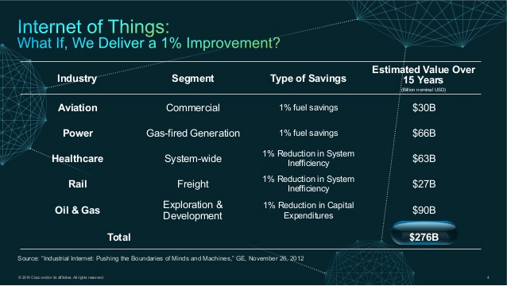

Slide 11
IoT & Business Automation

Slide 12
“Everything that can be automated, will be automated.”
~ Robert Cannon

Slide 13
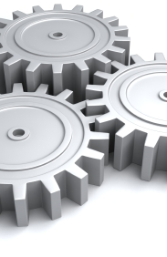
Automation
Let machines do the hard work

Slide 14
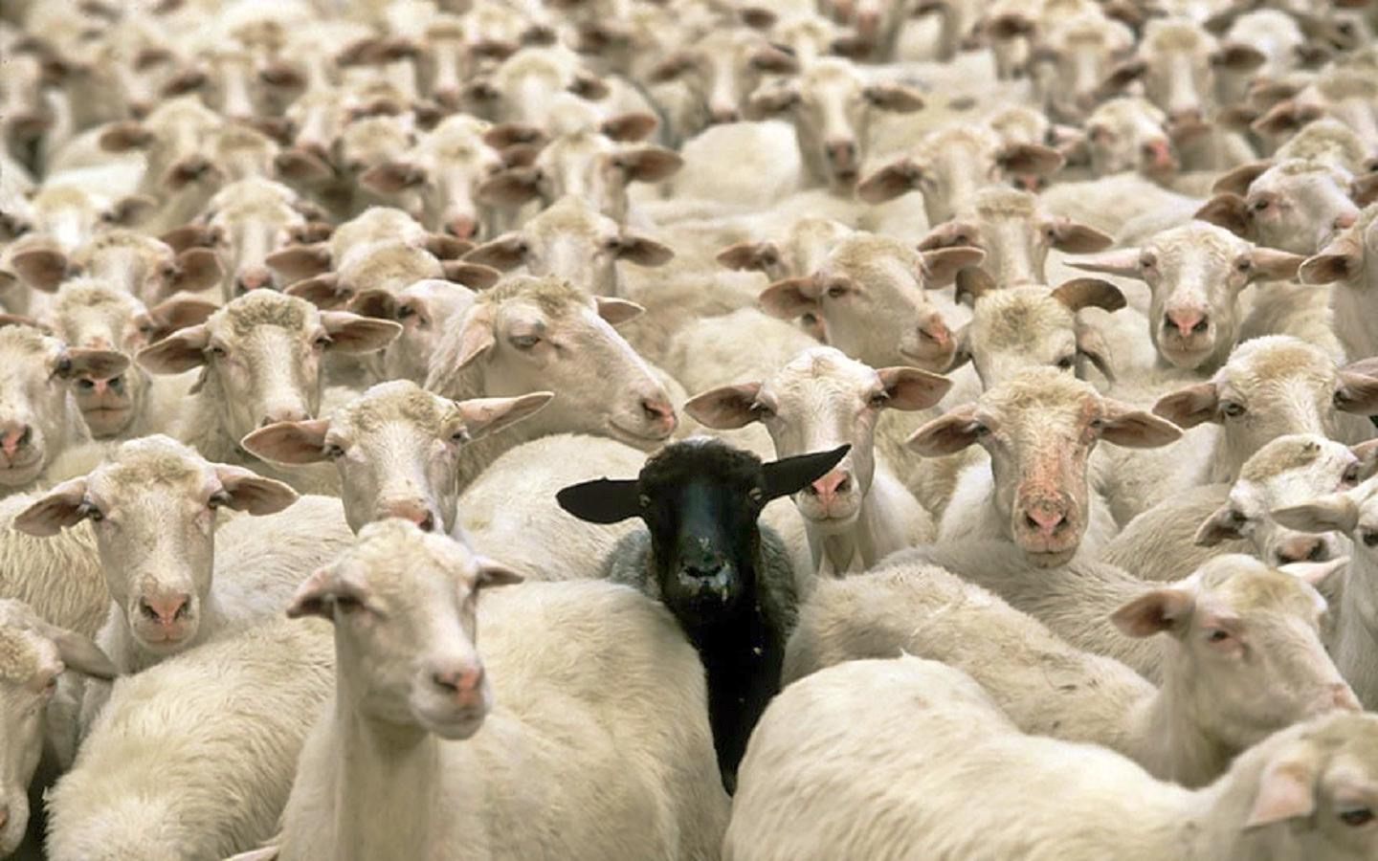
Machine Learning
Anomaly detection

Slide 15
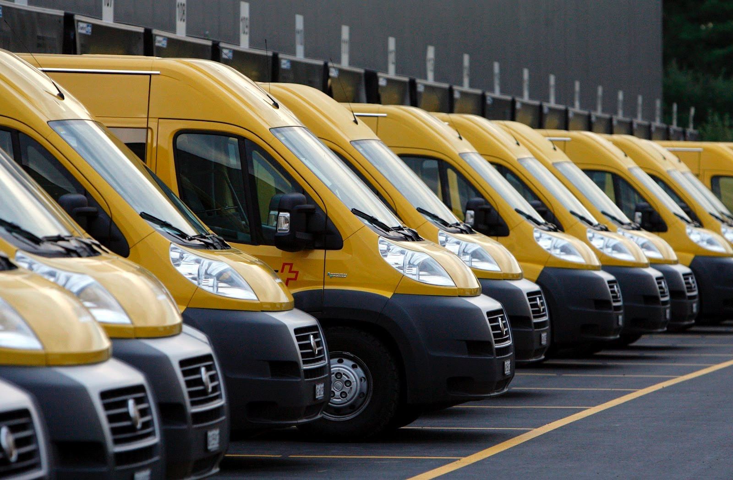
Machine Learning
Event prediction

Slide 16
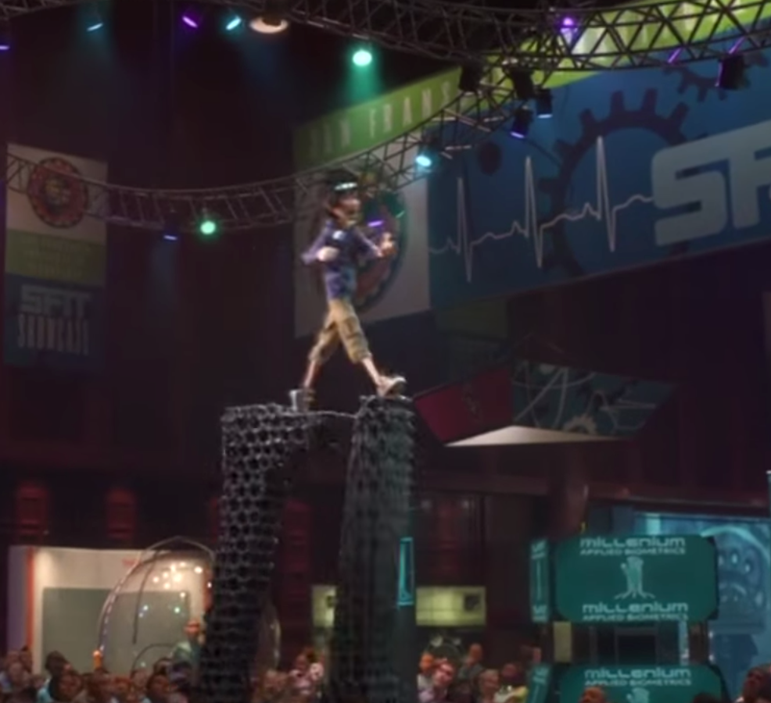
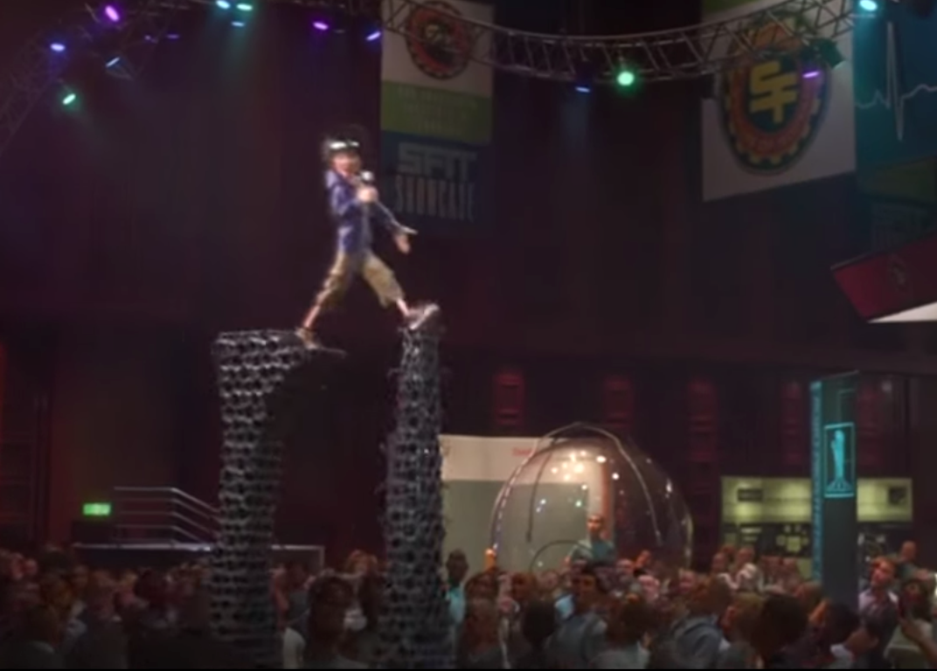
Machine Learning
Context aware systems

Slide 17
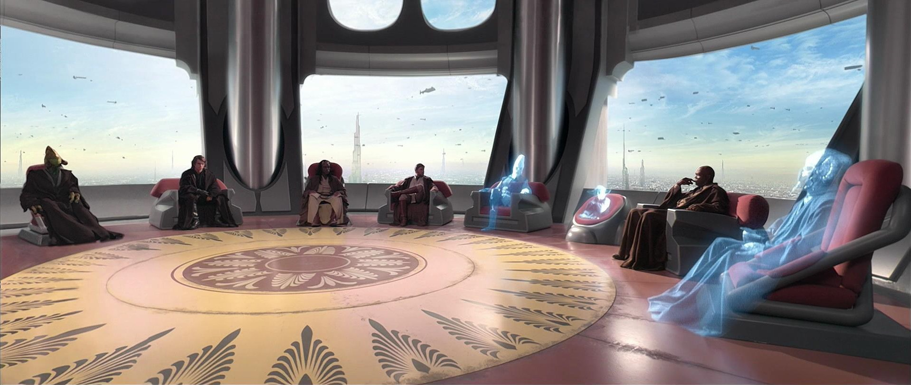
Human Interaction
Humans have the power of personality and creativity, automate the rest.

Slide 18
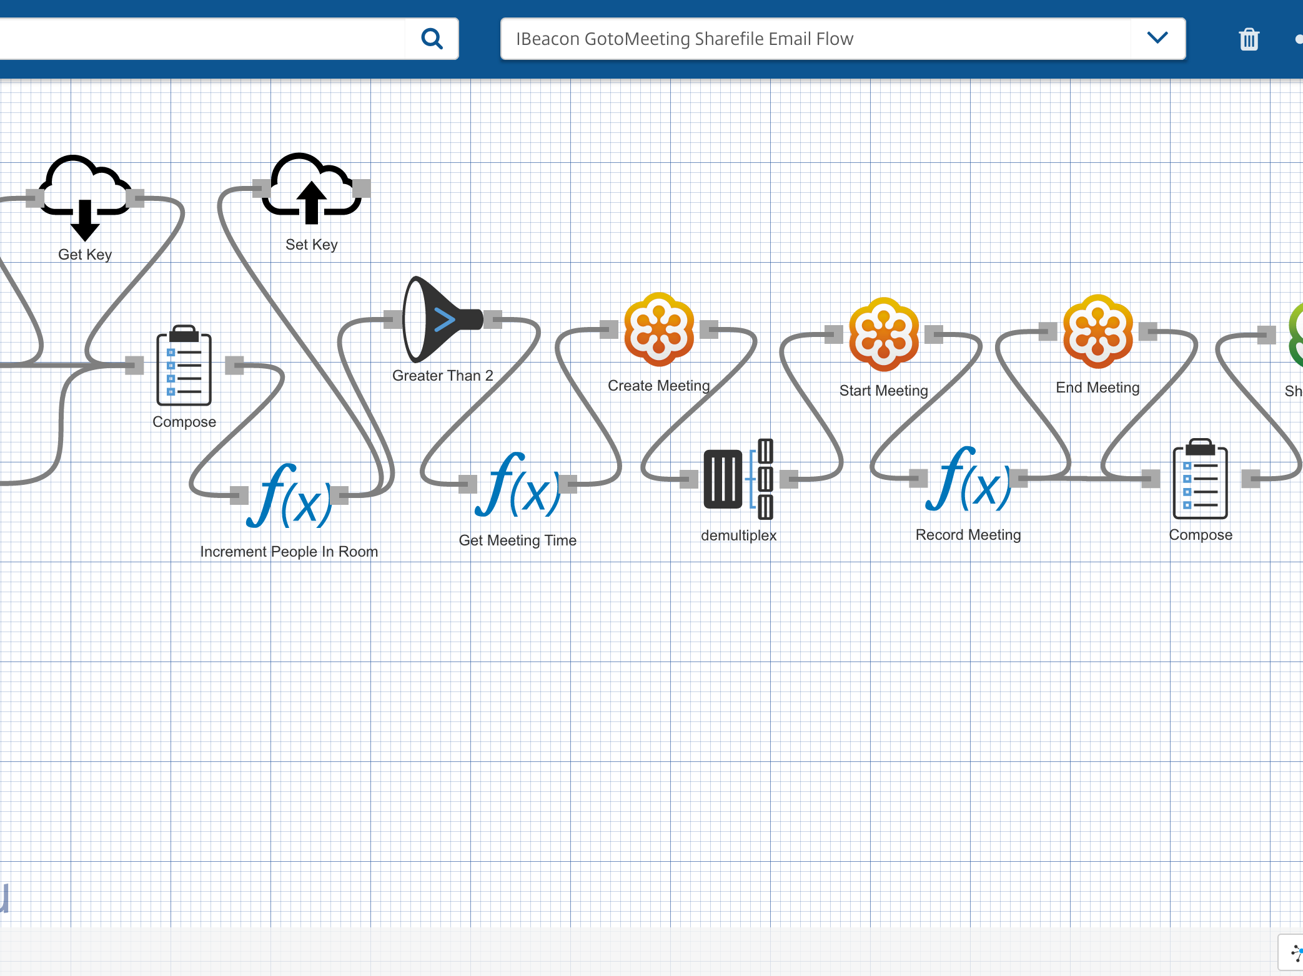

Octoblu
The Internet of Things operating system

Slide 19
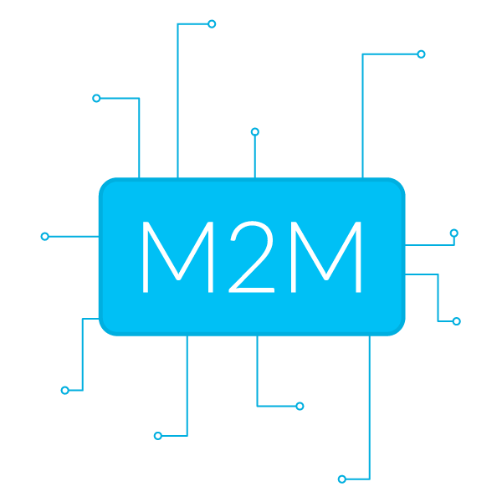
Talking to devices is hard, we make it easy

Slide 20
How to IoT

Slide 21
Be Lazy

Slide 22
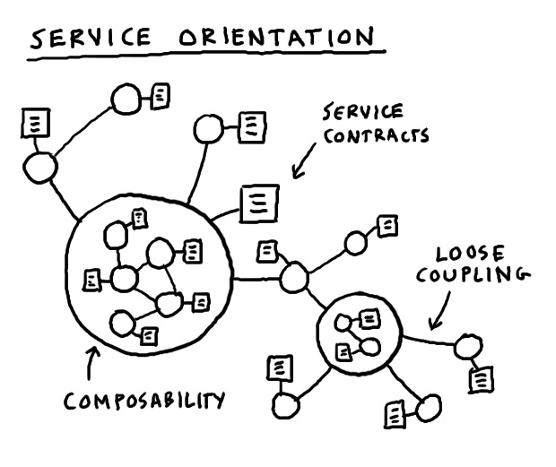
Microservices
Complex applications written in small independent programs

Slide 23
Machines cost far less than humans

Slide 24
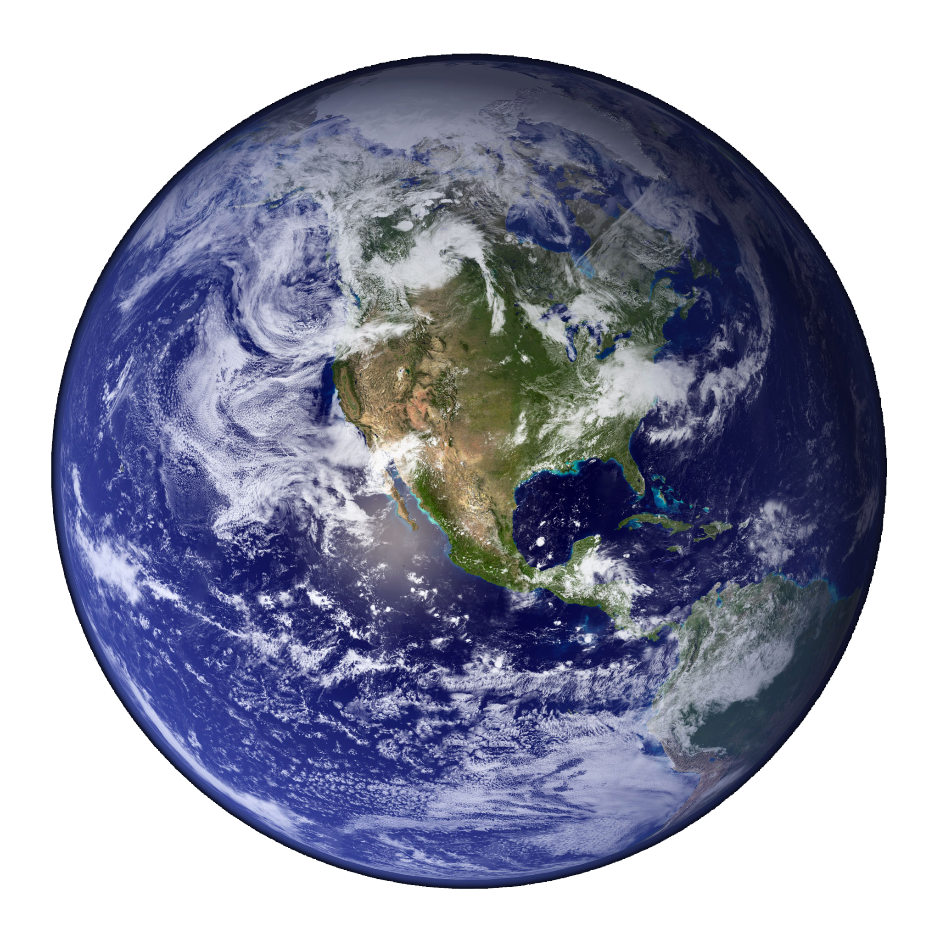
Make the world a better place

Slide 25
Roy van de Water
UUID: ~69286630-0862-11e4-b1c7-4f6f6e31e7b4
Twitter: @royvandewater
Email: r@octoblu.com
Slide Deck available at
https://github.com/royvandewater/rise-of-the-machines-talk/

